Slide 1
Heart Disease Mortality Rate determination.

Slide 2
Brief Data Description
In order to shed light on the subject of heart disease, we chose to look at and work with the chosen study in order to understand the mortality rates of this sometimes inviable disease amongst the population, and to also see if location has any relevance to this problem. This is intended for any audience with an interest towards the same subject, and is meant to increase the total knowledge of this disease, without bias against or towards any particular group, gender or ethnicity. Heart Disease knowns no bounds.

Slide 3
Data Preprocessing
Imported libraries used:
import pandas as pd
import numpy as np
import matplotlib.pyplot as plt
Visualization method:
Jupyter Notebook

Slide 4
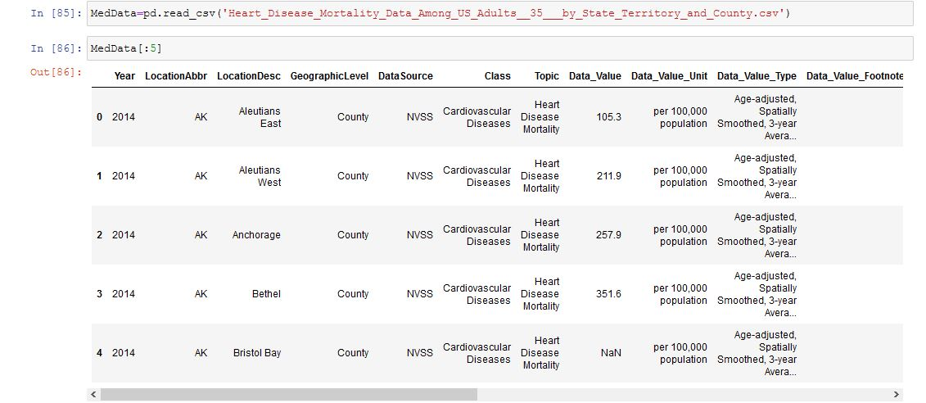
Data Preprocessing – Cont.
Imported Data Set:

Slide 5
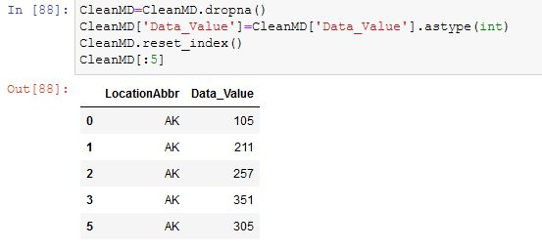
Data Preprocessing – Cont.
Dropped the null values in order to calculate the data accurately.

Slide 6
Data Preprocessing – Cont.
The categorical values chosen were the states of the U.S., based on the mean.
Post this slide will provide the story or our findings in order to convey our proposed ideology on heart disease in the U.S. and the threat it poses for a large population of the states.

Slide 7
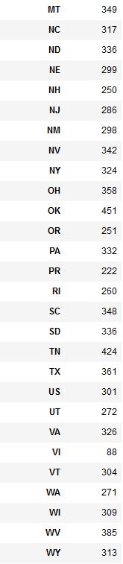
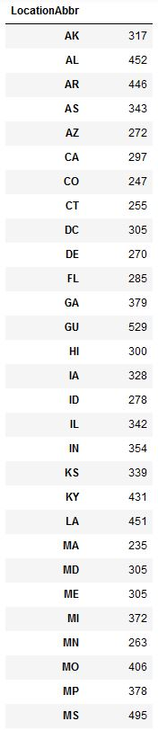
Story of our findings – Cont.
Below is a list of the states by mean
In order to accomplish the data based on state, we grouped by that column in the data set.
“Data=CleanMD.groupby(['LocationAbbr']).mean()
Data['Data_Value']=Data['Data_Value'].astype(int)
Data”

Slide 8
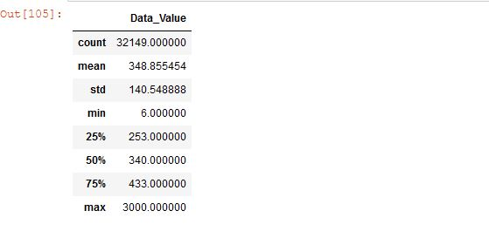
Story of our findings – Cont.
By describing the data, we were able to determine the variations which supports the ideology that Heart Disease should be taken seriously.

Slide 9
Story of our findings – Cont.
Through the data we can conclude the following:
The minimum value is 66 deaths per 100,000
The maximum value is 3000 out of 100,000
Both are huge outliers considering the mean and standard deviation
Heart Disease can be said to take about .5% of the population

Slide 10
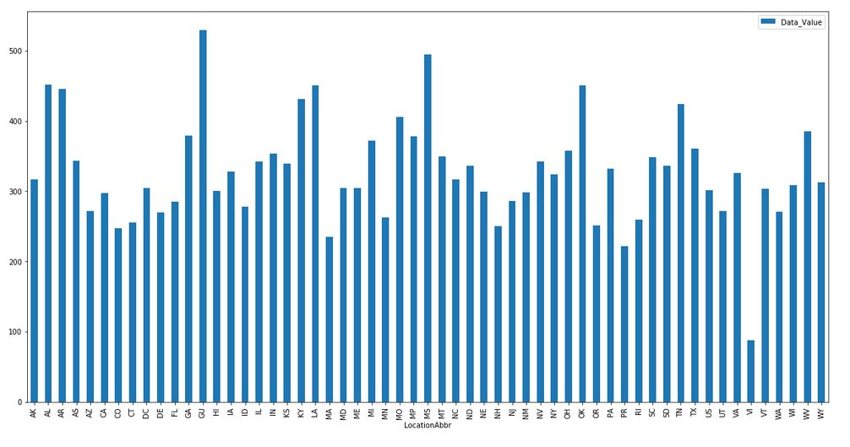
Story of our findings – Cont.
We chose a bar plot in order to visualize the data, finding that it fit best for the dataset. Though it does have some troubles, it makes distinct counts for individual states, which other such plots would not have done nearly as well.

Slide 11
Conclusion
We wondered how differences in location might have an effect on heart disease mortality data. The chosen visualization clearly answers this question; yes, it appears to be related, though it appears clear that location is but a single part of a much larger puzzle.
Data variance shows several intriguing maxes and minimums. Guam shows the highest rate of heart disease, while the virgin isles shows the least, respectively averaging 529 and 88. Large states have lower death counts than smaller ones (California has 297 deaths which is on the low end of the average), and it seems land bound states have higher counts that costal ones at a brief glance.

Slide 12
Conclusion – Cont.
More variables would better the data, such as age of patient, sex, or economic stance, but that data was unavailable. What we have does appear to show correlation with location, with surprising numbers in the whole data as well as in the average. Overall, we feel that this shines good light on the subject at hand, that being the count of deaths by heart disease by location, and hope that this will better increase the knowledge of the subject.

Slide 13
Heart Disease Mortality Rate determination.
By:
Mark Ohde
Sebatian Ohde
Mike Pendleton

